Slide 1

ALUMNI MANAGEMENT SYSTEM
Project Supervisor: Dr. R. M. Gomathi , M.Tech., Ph.D.,
Name of the Student: Ms. Sowmiya S
Register Number: 39120117

Slide 2
Presentation Outline
Introduction
Objectives
System Architecture / Ideation Map
Methodology
Project Implementation
Application Snapshots
Conclusion
References

Slide 3
Introduction
The greatest asset any institution can have is the Alumni Portal. Alumni are the people who represent the institution in the real world.
This is an online website that allows former students (alumni) to take advantage of the benefits and services that an institution offers after graduation.
This platform will acts as an interface between the alumni and the institution.

Slide 4
Objectives
To build an application that increase the alumni-alma mater contact.
To provide user-friendly interface.
To reduce manual work.
To allow alumni of a university or college to communicate with each other. This allows them to know about the current activities.
The objective is to build a web application which can be used as a Alumni Management System that has an easy-to-use interface.

Slide 5
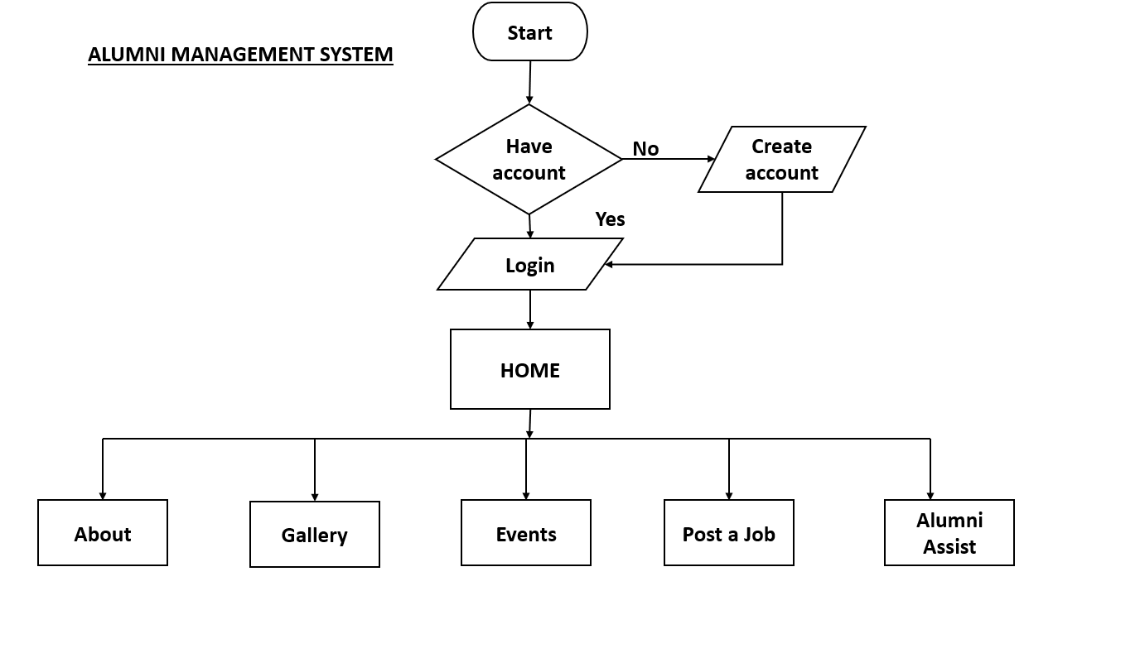
System Architecture/ Ideation Map

Slide 6
Methodology
The first step is to create the front-end for the application.
Design the web application with the features like Home, Alumni Login/ Signup, Alumni Home, About us, Events, Gallery, Alumni Assist, Admin Login, Admin Dashboard etc.,
All the front-end things can be done using basic technologies like HTML, CSS and JavaScript.
Then for the backend PHP is used to make the connection with MySQL database and to connect with the server.
The website can be hosted locally using the XAMPP server localhost.

Slide 7
Project Implementation
The system has two main modules
Alumni module
Admin module
Alumni module:
The alumni will be able to login/ signup to the system. They will be able to view the upcoming events and photo gallery.
They will be able to send queries and post job opportunities for the students
They will be able to share their achievements with the institution and they can submit requests for conducting events and to be student mentors.

Slide 8
Project Implementation
Admin module:
The admin will have the access to the system after login.In the dashboard, he or she will be able to see the number of requests received . They will have access all of them.
The admin can do CRUD operations in the upcoming events module. They have the ability to add/delete events that have been displayed in the Alumni portal's "Events" section.
The admin has the ability to download career opportunities posted by alumni and share them with the institution's placement department.

Slide 9
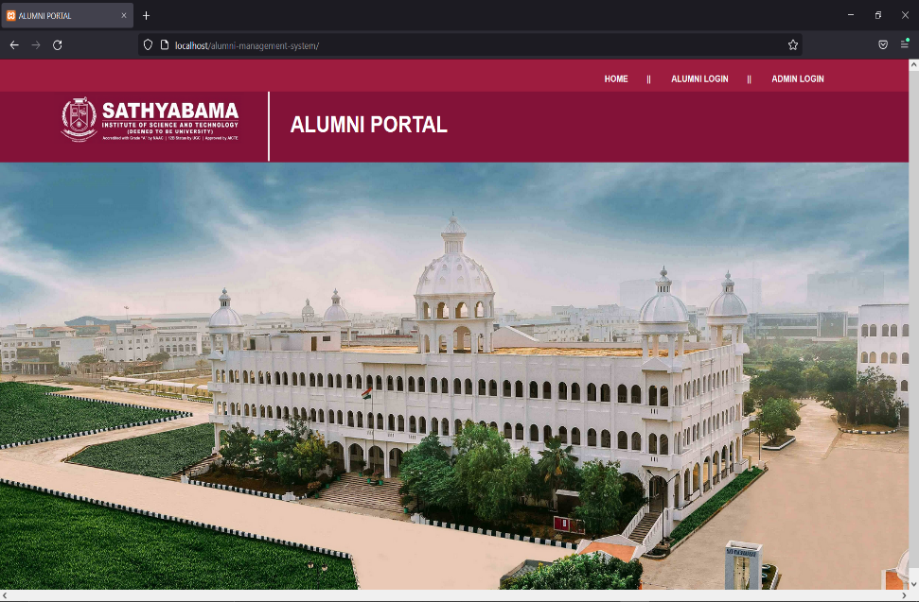
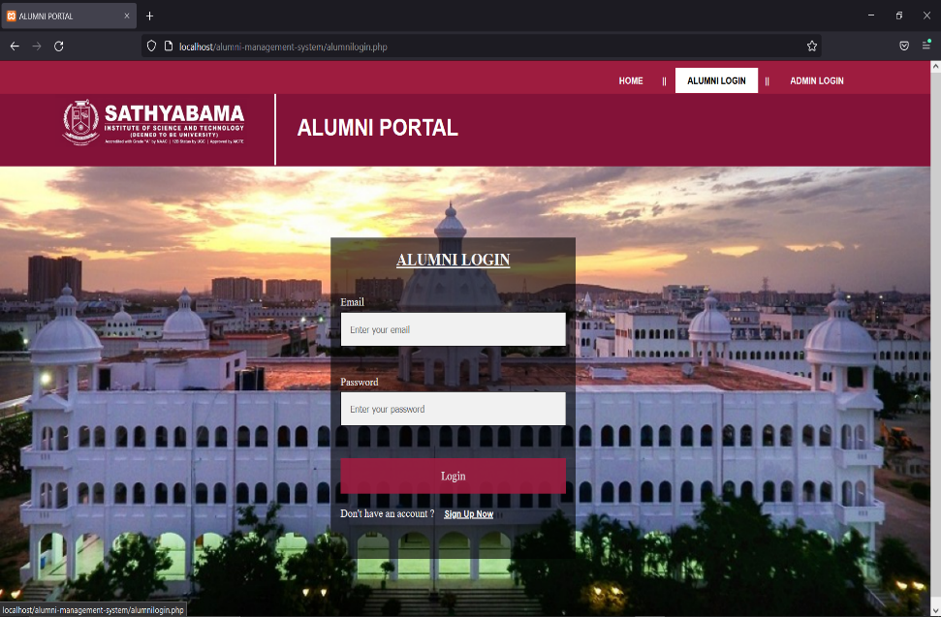
Project Snapshots
1. Home Page
2. Login

Slide 10
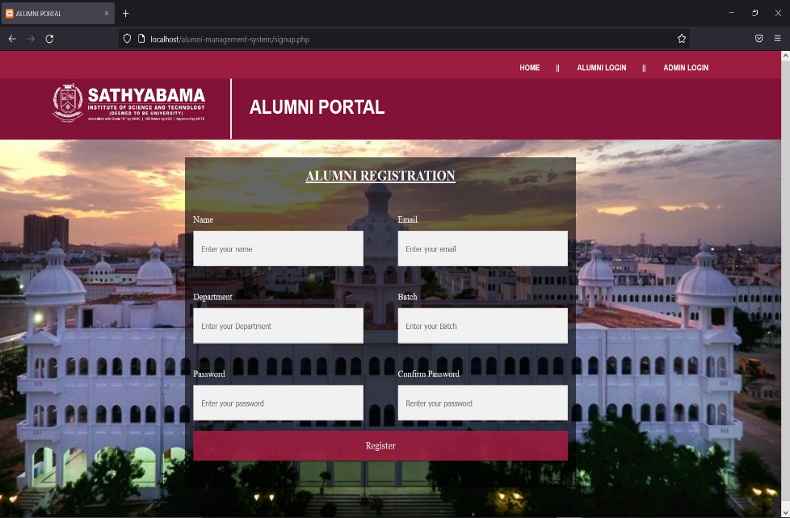
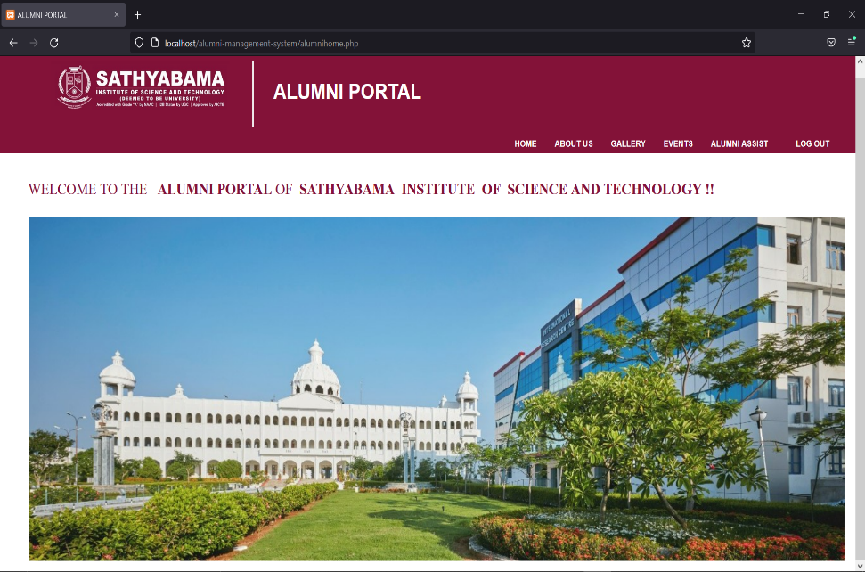
Project Snapshots
3. Signup
4. Alumni Home

Slide 11
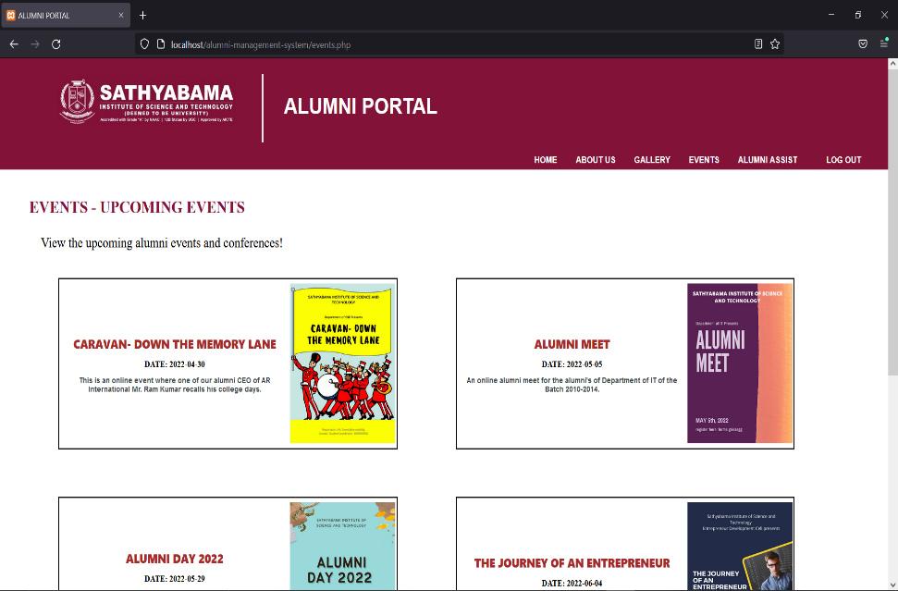
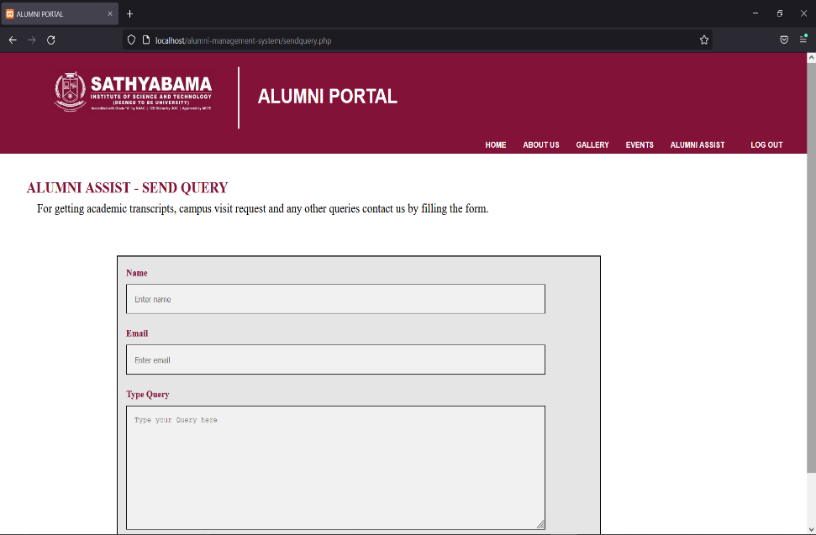
Project Snapshots
5. Upcoming Events
6. Alumni Assist

Slide 12
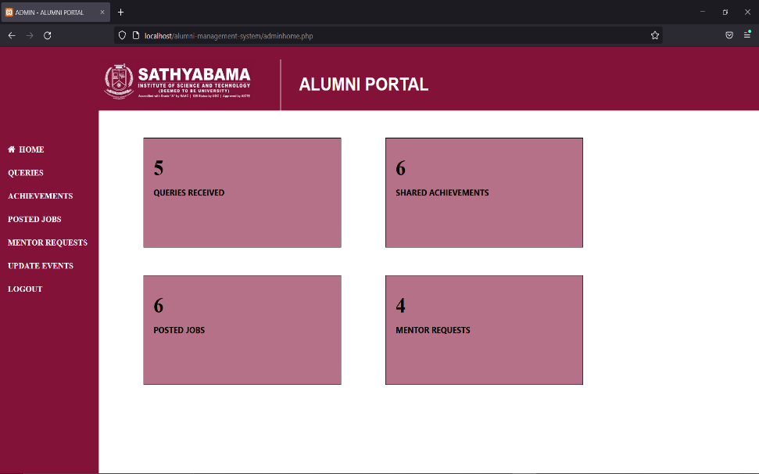
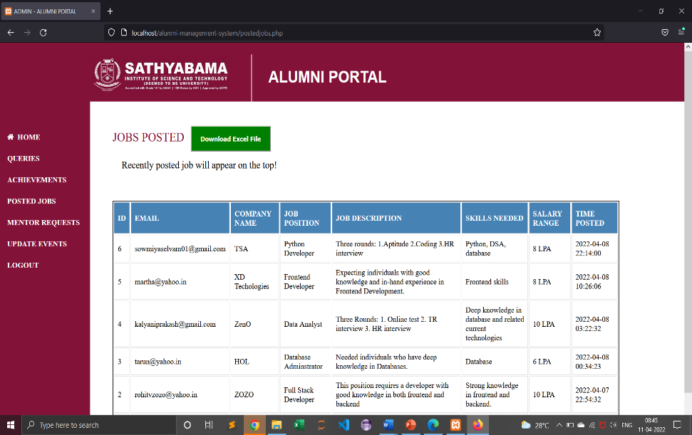
Project Snapshots
7. Admin Dashboard
8. Posted jobs

Slide 13
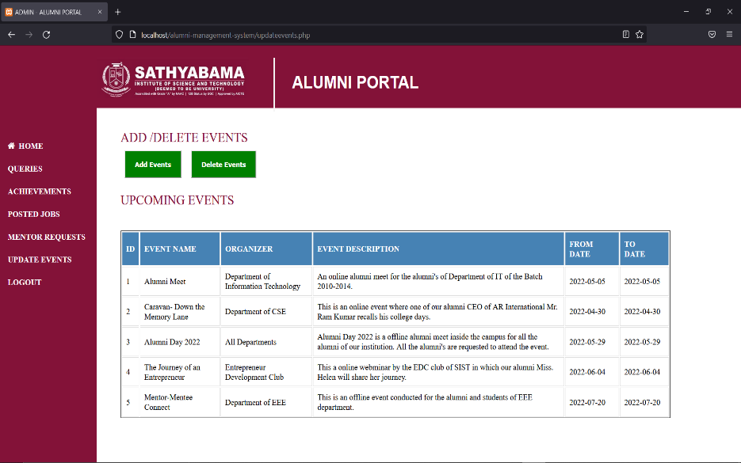
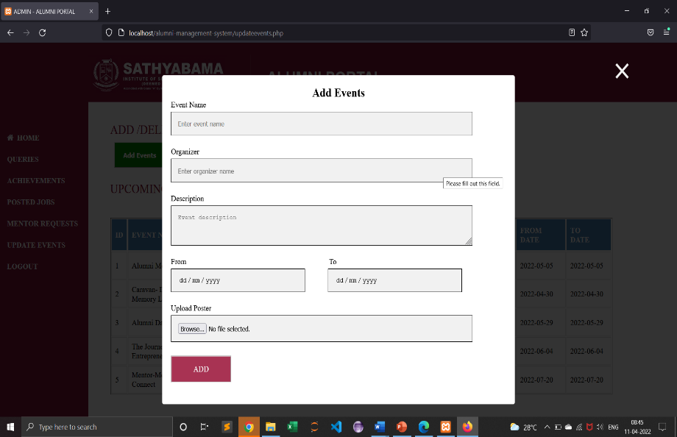
Project Snapshots
9. Update events
10. Add events

Slide 14
Conclusion
A strong alumni network is extremely important for the success of an educational institution.
Communication between alumni and the institution is simplified by using this Alumni Management System.
The system also acts as a valuable portal for knowing about what is going on at the university and learning about various opportunities in the outside world.
In the future, this system can be improved by adding more functionality to both the alumni and admin sides.

Slide 15
References
IIM Indore Alumni Portal has been taken as reference for the website- www.alumniportal.iimidr.ac.in
For PHP and MySQL- www.w3schools.com

